Slide 1


WhammyPlug
POLITECNICO DI MILANO

Slide 2


Project’s goal
This project aims at reproducing the Whammy Pedal functioning, thus, it implements a Pitch Shifter;
The pitch shift technique allows to change the pitch of the input audio signal without changing its original tempo;
The pitch shifting operation is implemented on the two channels of the input audio signal, therefore each channel is treated as mono;
The project is implemented using the Juce framework for audio plugins.
POLITECNICO DI MILANO

Slide 3
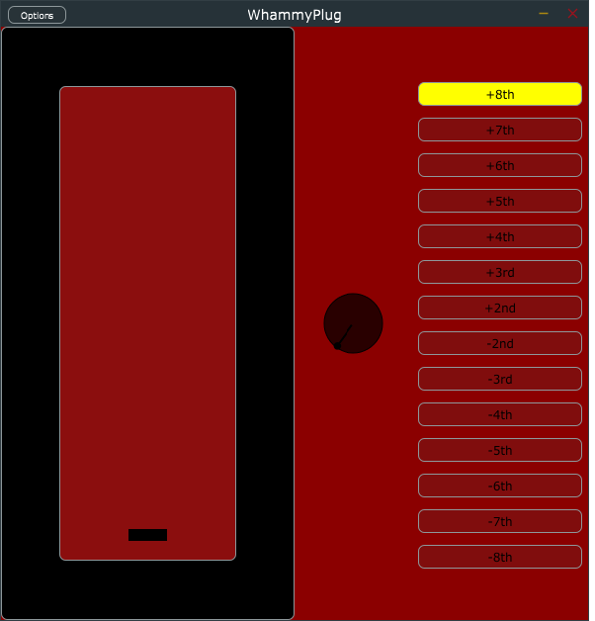
User Interface
POLITECNICO DI MILANO

Slide 4
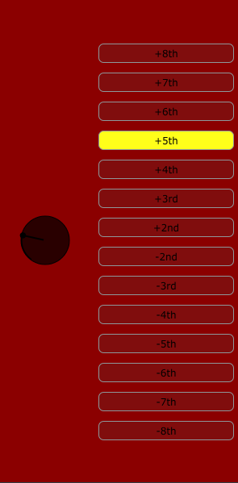
Knob and Buttons
The black knob on the left can be used to select one of the possible intervals indicated on the buttons;
As the user turns the knob, one button will become yellow, meaning that the corresponding interval is selected;
By turning the knob clockwise the values go from an octave to a negative octave;
The selection of an interval is used to set the maximum number of semitones that the pitch shifting operation will reach.
POLITECNICO DI MILANO

Slide 5

Pedal Slider
This slider is meant to act as a pedal;
Once the user has set the maximum interval for the pitch shift operation, the input signal will be modified according to the movement of this slider;
The slider moves from 0 semitones (meaning we are going to hear the original signal) to the number of semitones corresponding to the maximum pitch interval chosen with the knob.
POLITECNICO DI MILANO

Slide 6
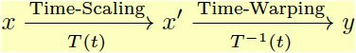
SoundTouch Library
SoundTouch is a C++ library for time and pitch scaling;
It should be capable of processing interleaved stereo blocks, in actual facts, though, the result isn’t satisfying. That’s why we went through the dual-mono path;
Pitch scaling is implemented combining time-scaling (implemented with SOLA algorithm) and resampling:
POLITECNICO DI MILANO

Slide 7
DAW & Requirements
This project can be used as a standalone application or as a VST plugin for a DAW;
In order for the standalone app to process an input audio signal, it is necessary to use a system for audio routing (like SoundFlower for MacOS, or Virtual Audio Cable for Windows);
This approach allows to route the input audio signal to the application, that then sends the output to the speakers.
POLITECNICO DI MILANO

Slide 8
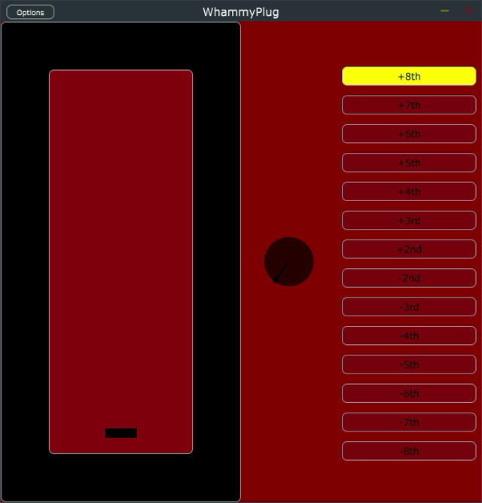
Demo 1
POLITECNICO DI MILANO

Slide 9
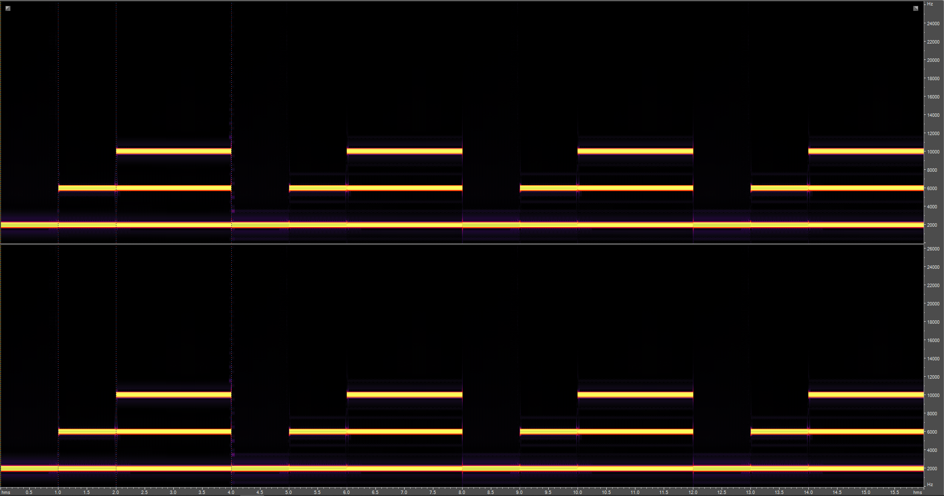
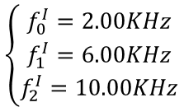
Report 1 – Test signal
$$\left\{\begin{aligned}f_{0}^{I}=2.00KHz \\ f_{1}^{I}=6.00KHz \\ f_{2}^{I}=10.00KHz\end{aligned}\right.$$
POLITECNICO DI MILANO

Slide 10
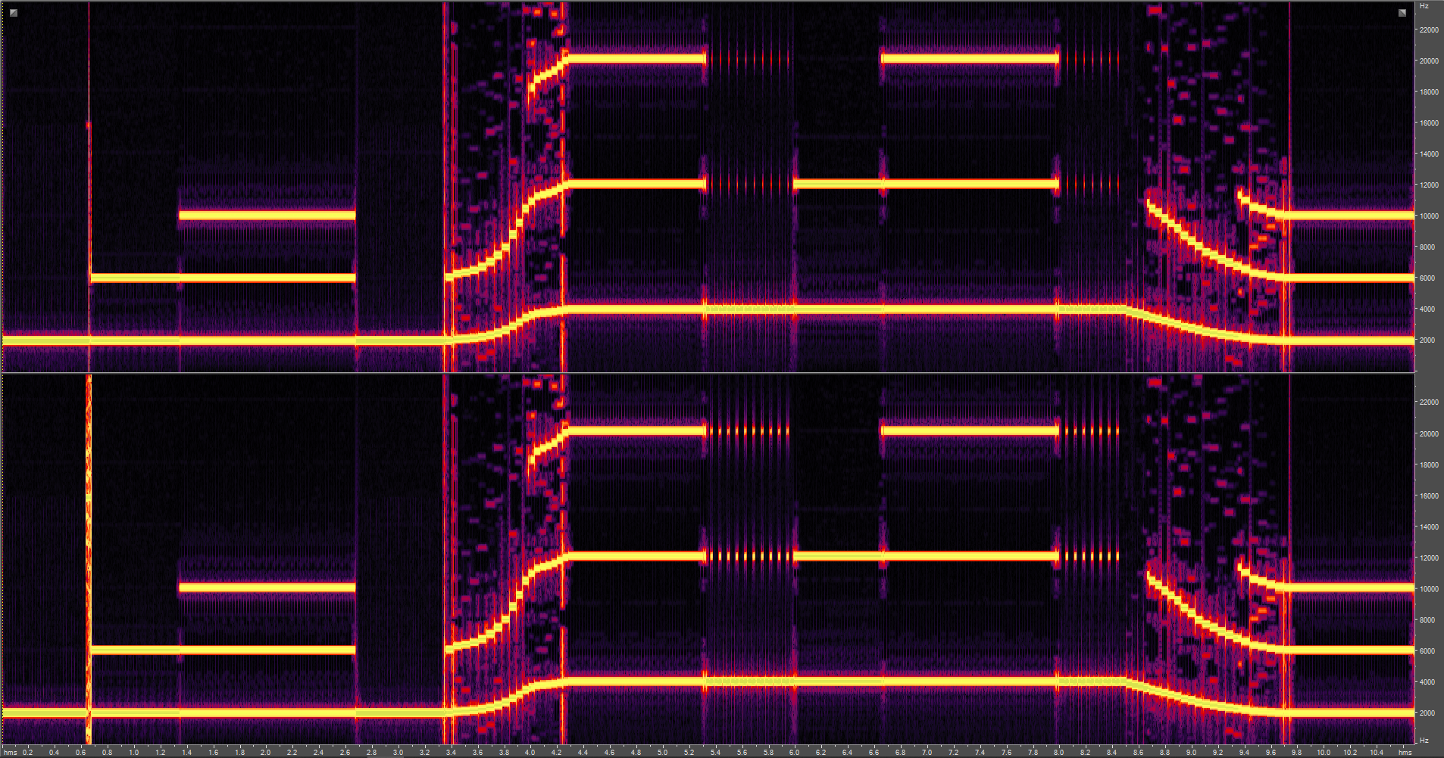
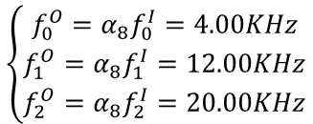

Report 1 – Test signal +8th interval
$$\left\{\begin{aligned}f_{0}^{I}=2.00KHz \\ f_{1}^{I}=6.00KHz \\ f_{2}^{I}=10.00KHz\end{aligned}\right.$$
$$α_{8}={\left(\sqrt[12]{2}\right)}^{HT\left(8\right)}={\left(\sqrt[12]{2}\right)}^{12}=2$$
$$\left\{\begin{aligned}f_{0}^{O}=α_{8}f_{0}^{I}=4.00KHz \\ f_{1}^{O}=α_{8}f_{1}^{I}=12.00KHz \\ f_{2}^{O}=α_{8}f_{2}^{I}=20.00KHz\end{aligned}\right.$$
POLITECNICO DI MILANO

Slide 11
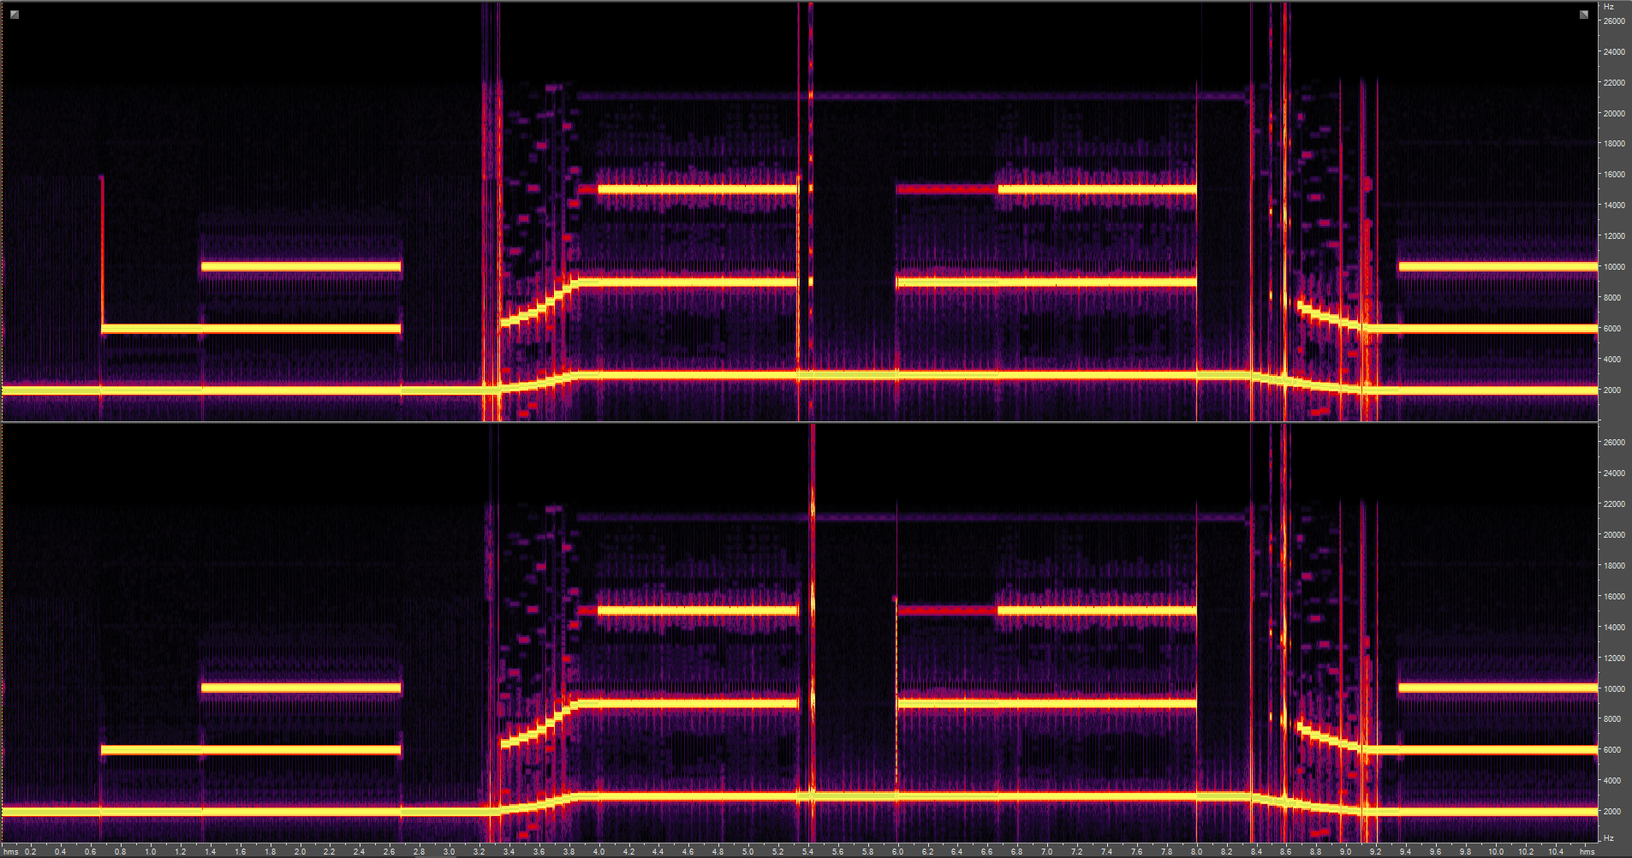
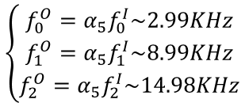

Report 1 – Test signal +5th interval
$$\left\{\begin{aligned}f_{0}^{I}=2.00KHz \\ f_{1}^{I}=6.00KHz \\ f_{2}^{I}=10.00KHz\end{aligned}\right.$$
$$α_{5}={\left(\sqrt[12]{2}\right)}^{HT\left(5\right)}={\left(\sqrt[12]{2}\right)}^{7}\sim 1.4983$$
$$\left\{\begin{aligned}f_{0}^{O}=α_{5}f_{0}^{I}\sim 2.99KHz \\ f_{1}^{O}=α_{5}f_{1}^{I}\sim 8.99KHz \\ f_{2}^{O}=α_{5}f_{2}^{I}\sim 14.98KHz\end{aligned}\right.$$
POLITECNICO DI MILANO

Slide 12
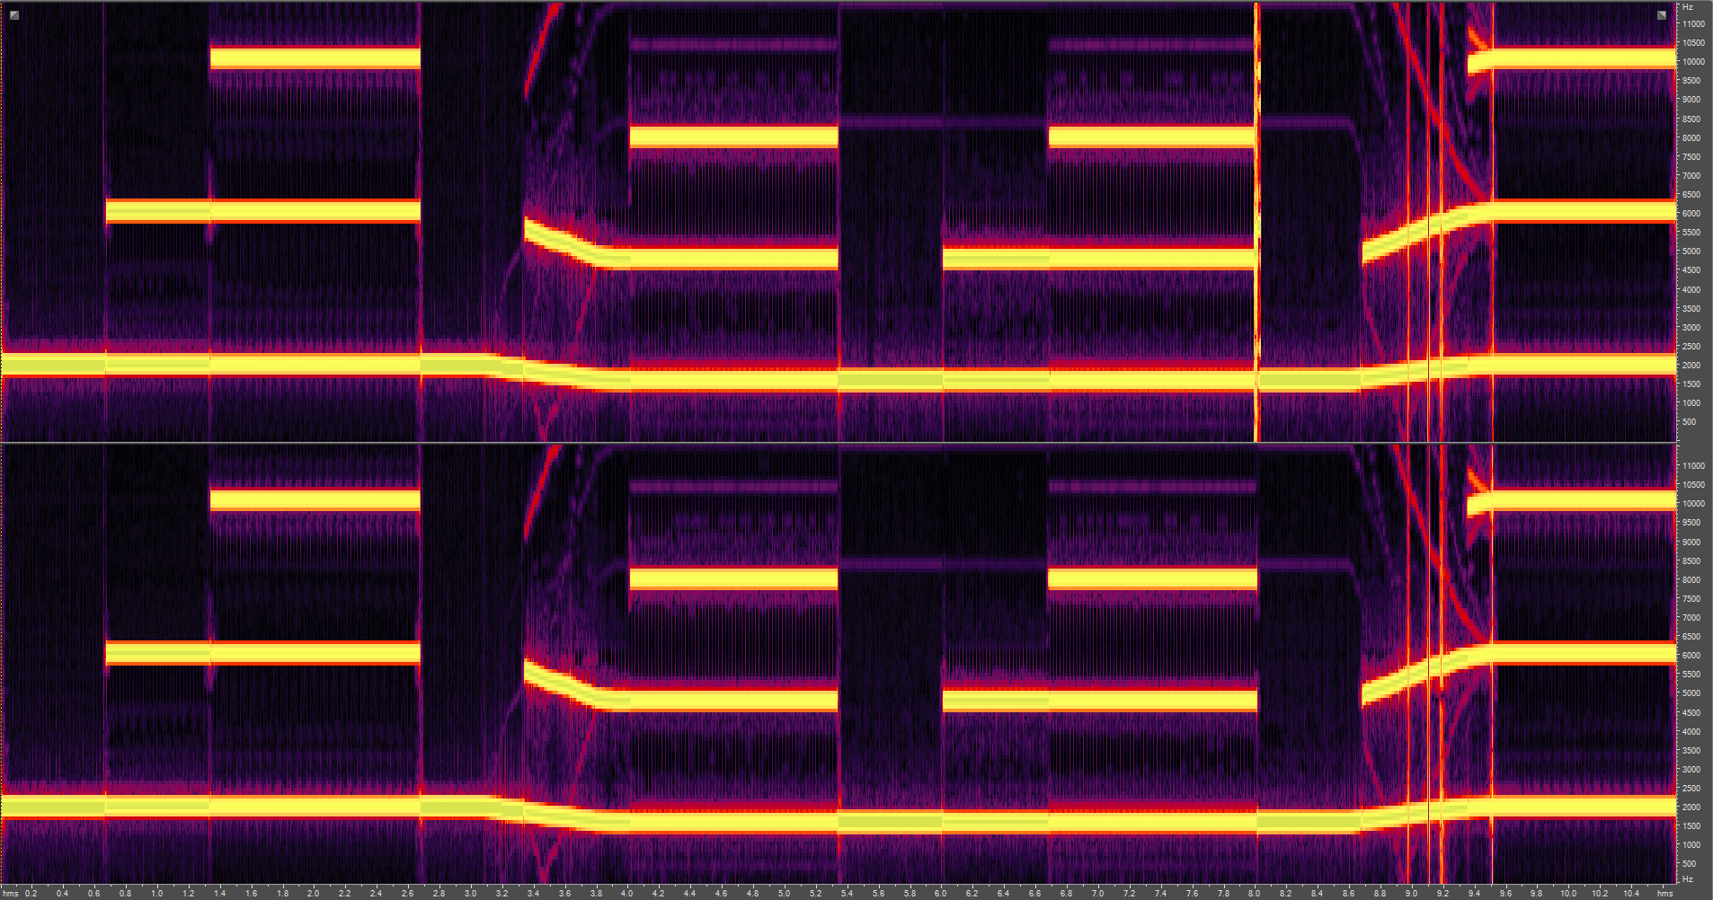
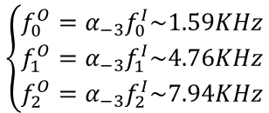
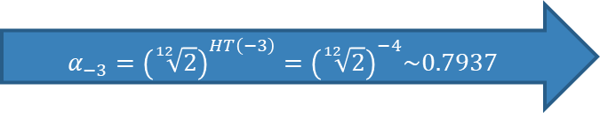
Report 1 – Test signal -3rd interval
$$\left\{\begin{aligned}f_{0}^{I}=2.00KHz \\ f_{1}^{I}=6.00KHz \\ f_{2}^{I}=10.00KHz\end{aligned}\right.$$
$$α_{−3}={\left(\sqrt[12]{2}\right)}^{HT\left(−3\right)}={\left(\sqrt[12]{2}\right)}^{−4}\sim 0.7937$$
$$\left\{\begin{aligned}f_{0}^{O}=α_{−3}f_{0}^{I}\sim 1.59KHz \\ f_{1}^{O}=α_{−3}f_{1}^{I}\sim 4.76KHz \\ f_{2}^{O}=α_{−3}f_{2}^{I}\sim 7.94KHz\end{aligned}\right.$$
POLITECNICO DI MILANO

Slide 13
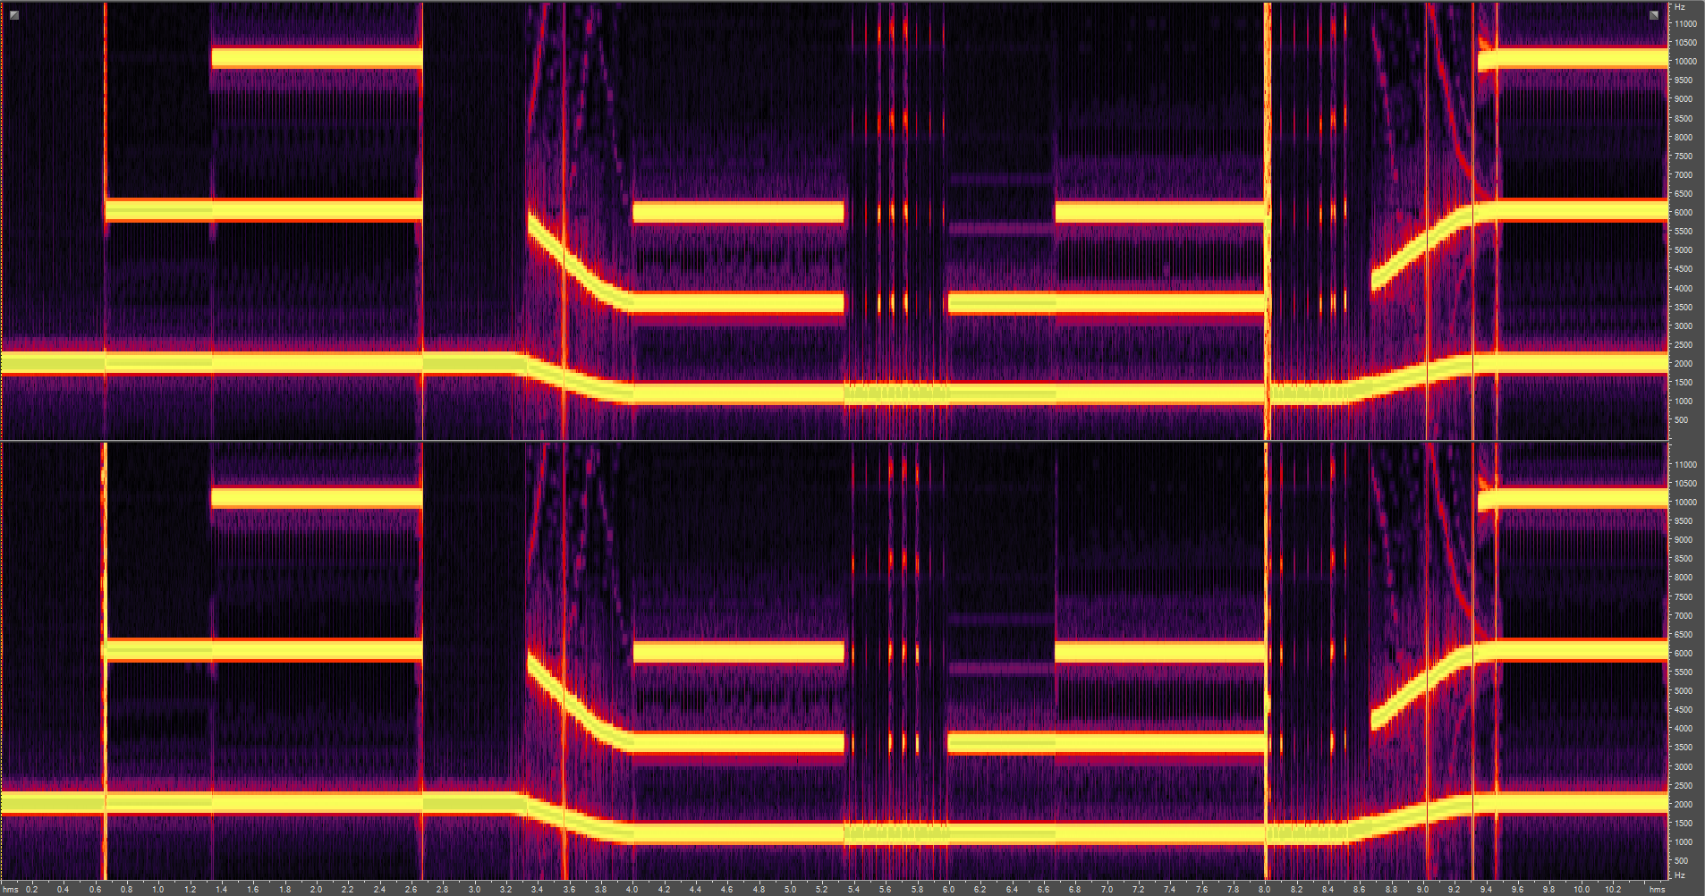
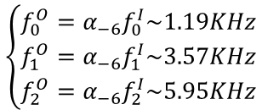
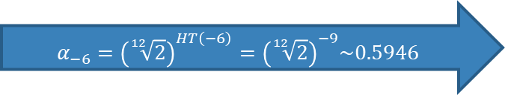
Report 1 – Test signal -6th interval
$$\left\{\begin{aligned}f_{0}^{I}=2.00KHz \\ f_{1}^{I}=6.00KHz \\ f_{2}^{I}=10.00KHz\end{aligned}\right.$$
$$α_{−6}={\left(\sqrt[12]{2}\right)}^{HT\left(−6\right)}={\left(\sqrt[12]{2}\right)}^{−9}\sim 0.5946$$
$$\left\{\begin{aligned}f_{0}^{O}=α_{−6}f_{0}^{I}\sim 1.19KHz \\ f_{1}^{O}=α_{−6}f_{1}^{I}\sim 3.57KHz \\ f_{2}^{O}=α_{−6}f_{2}^{I}\sim 5.95KHz\end{aligned}\right.$$
POLITECNICO DI MILANO

Slide 14
Improvements
To improve the quality of the output signal, interpolation and smoothing were introduced;
The type of interpolation that is used is the Lagrange Interpolation;
This kind of interpolation performs a linear combination of Lagrange basis functions of the input samples, in order to find the polynomial of lowest possible degree that passes through the points of the dataset (in this case, the audio samples).
POLITECNICO DI MILANO

Slide 15
Improvements
The smoothing is applied, instead, to the slider, in order to attenuate clicks related to the continuous variation of the pitch;
The smoothing consists in applying a ramp envelope to the slider movement, in order to have a gradual change of pitch, and avoid abrubt variations.
POLITECNICO DI MILANO

Slide 16

Demo 2
POLITECNICO DI MILANO

Slide 17
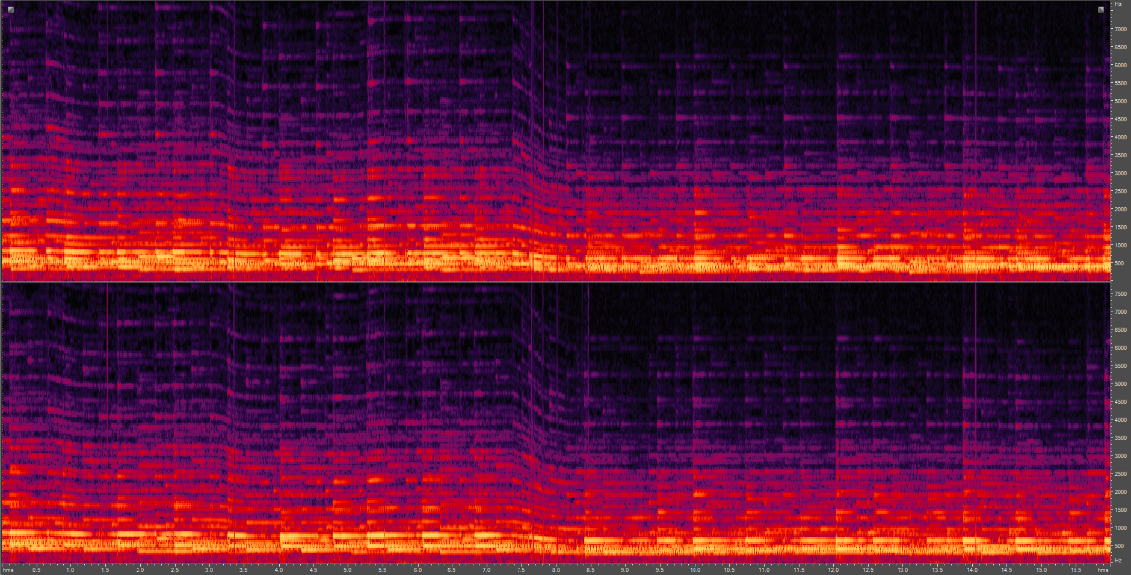
Report 2
POLITECNICO DI MILANO

Slide 18
Conclusions
The improvements tend to decrease the temporal density of the artifacts;
Indeed, it is possible to notice that the transitions between different pitch values are smoother with respect to the ones of the first reports;
It is possible that due to the mediocre quality of the recorder, the recording varies according to the signal level, and some results are not as satisfying as expected.
POLITECNICO DI MILANO

